Slide 1
Designing RF antennas with Ansys HFSS
Huan Q. Bui
ZGS July 7, 2023

Slide 2
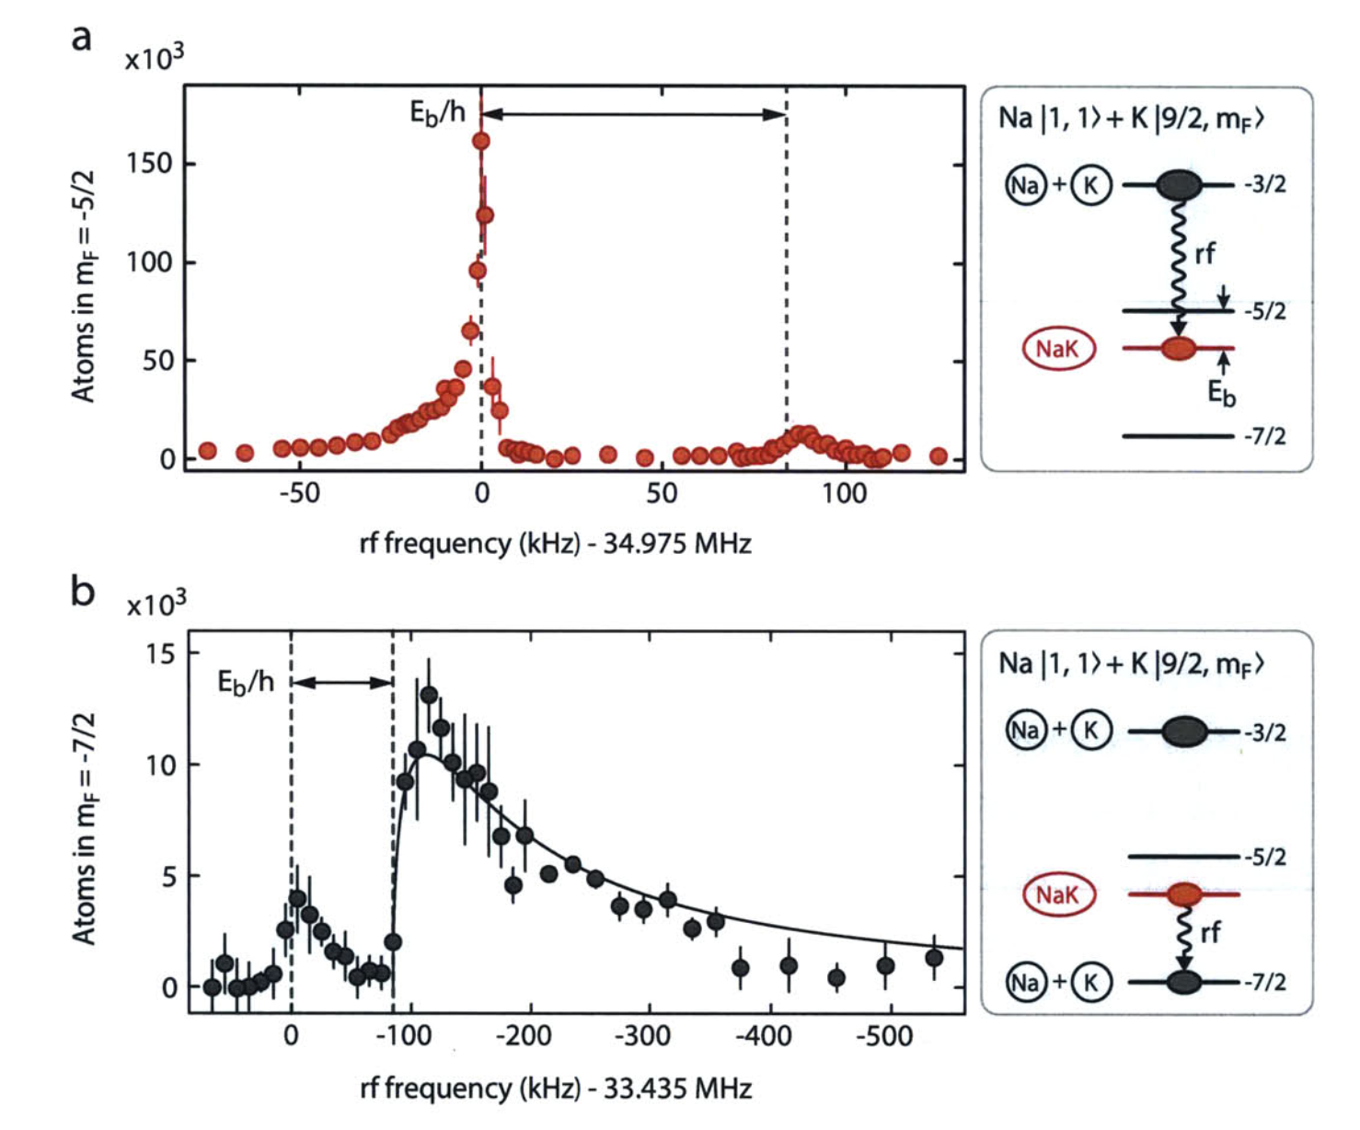
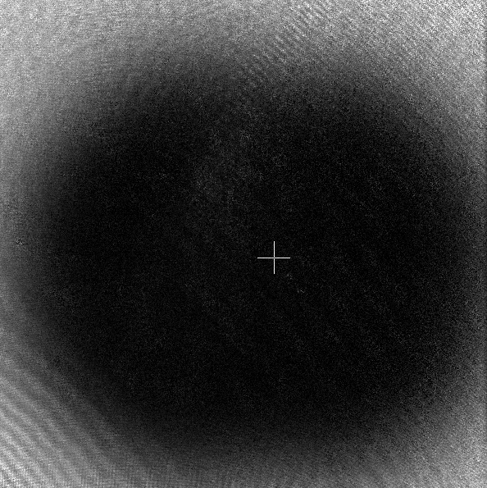
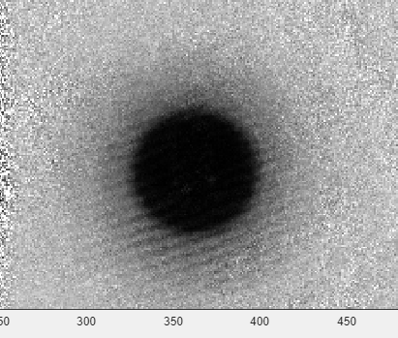
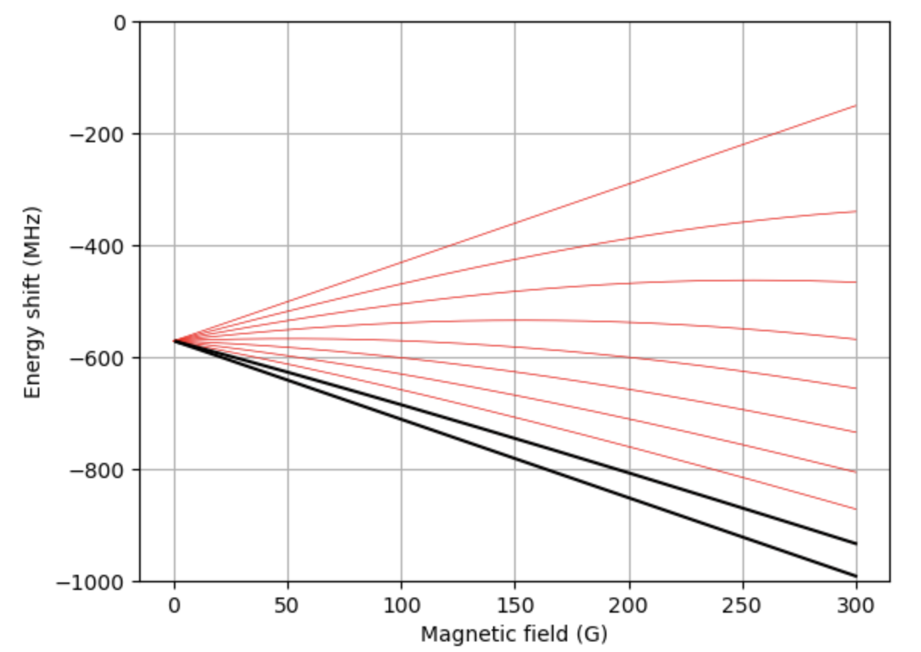
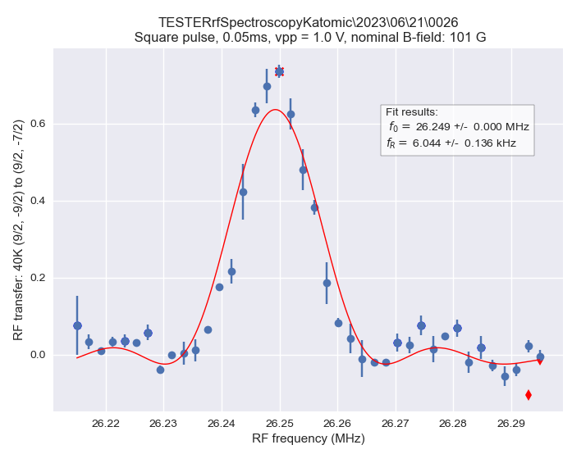
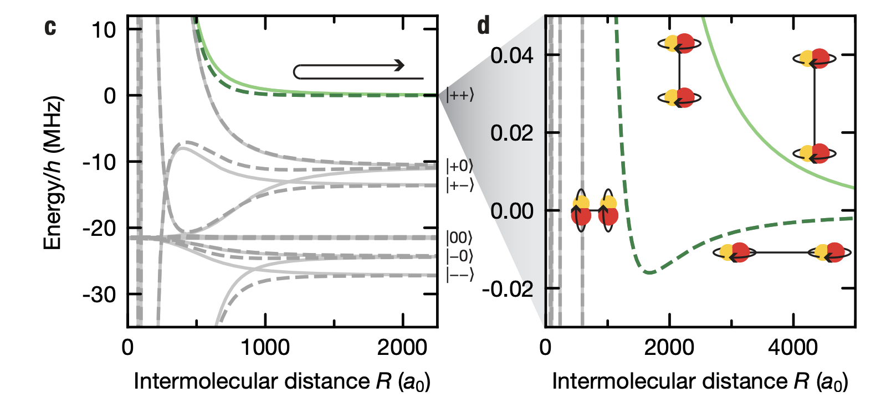
Why RF antennas?
Make/break molecules
RF evaporation
Cheng-Hsun, W., et al., Phys. Rev. Lett 109 (2012): 085301.
Spin manipulation
Tune molecular interactions (promised ZGS?)
Schindewolf, Andreas, et al. Nature 607.7920 (2022): 677-681.

Slide 3
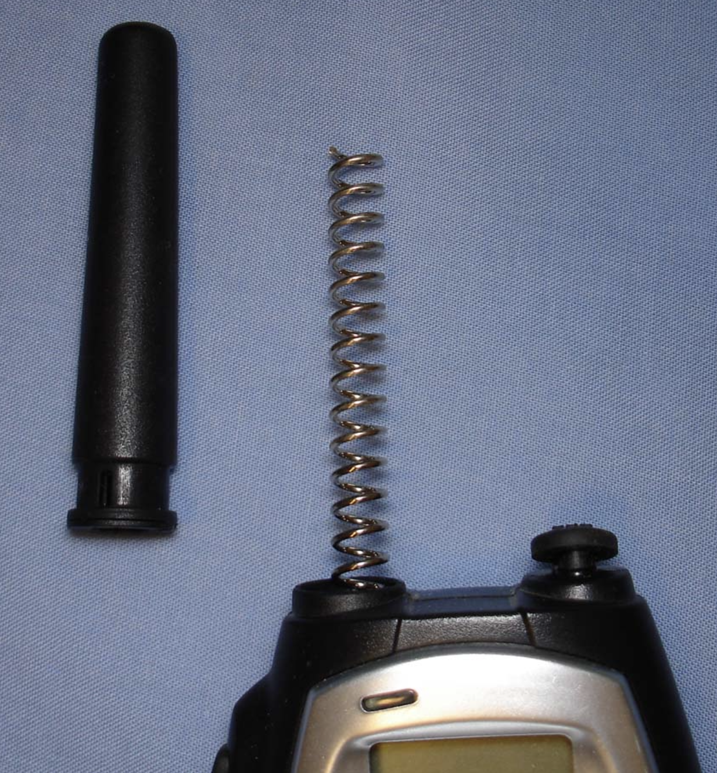
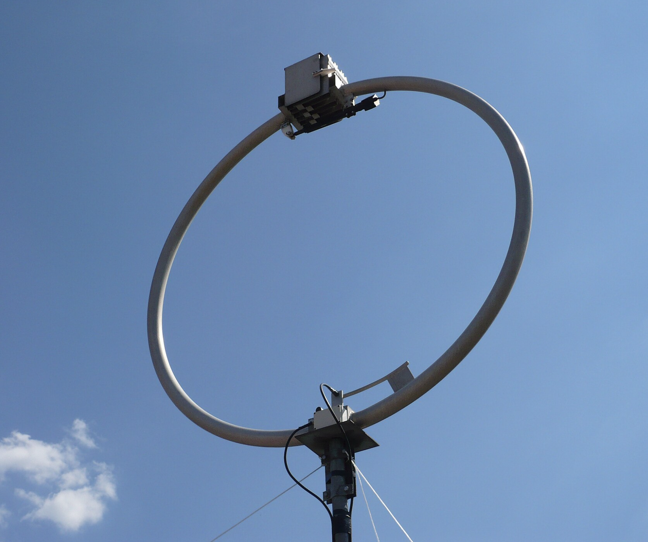
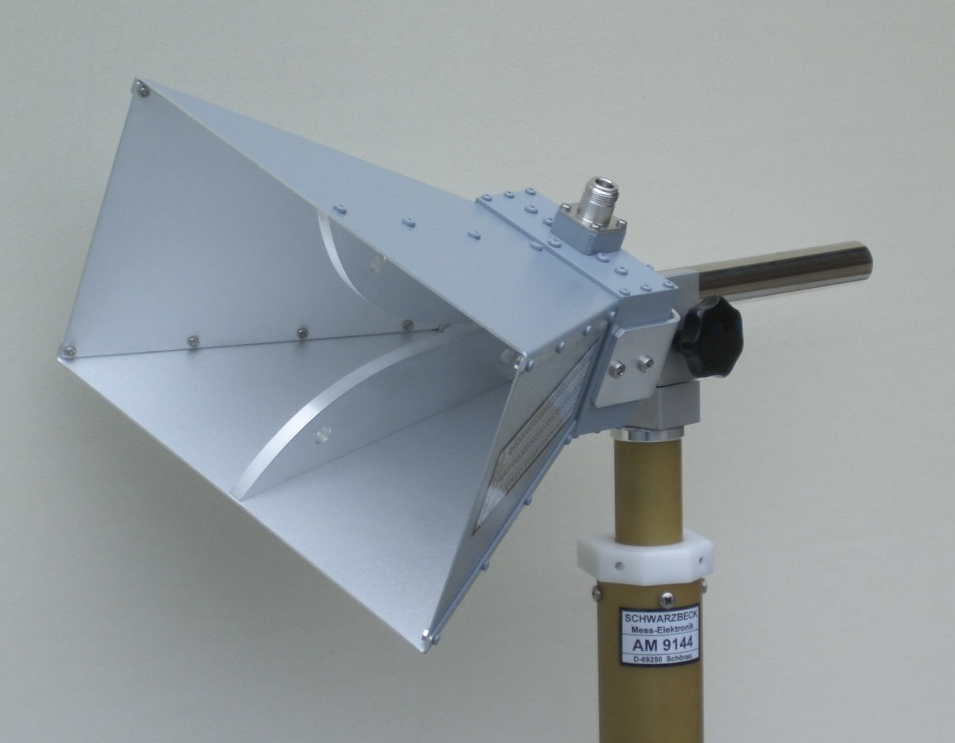
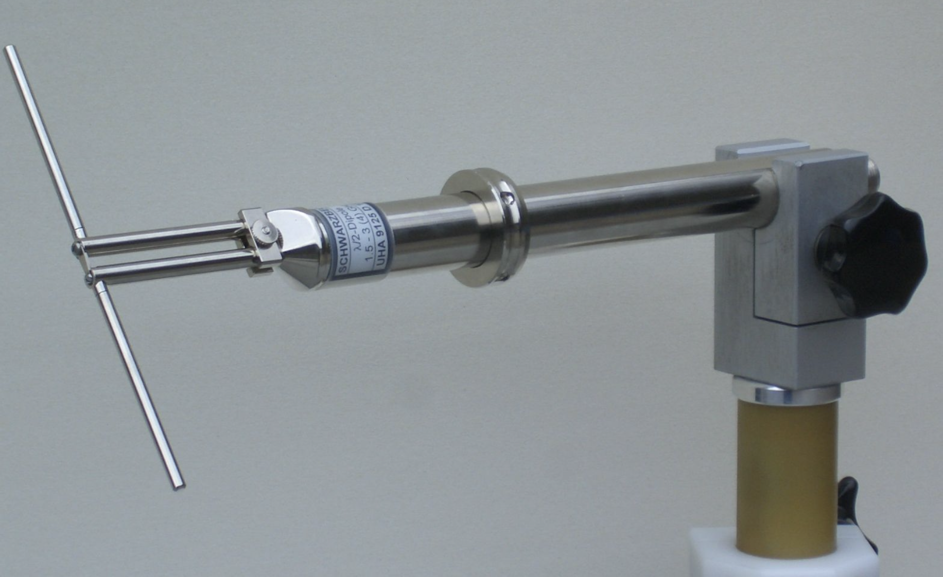
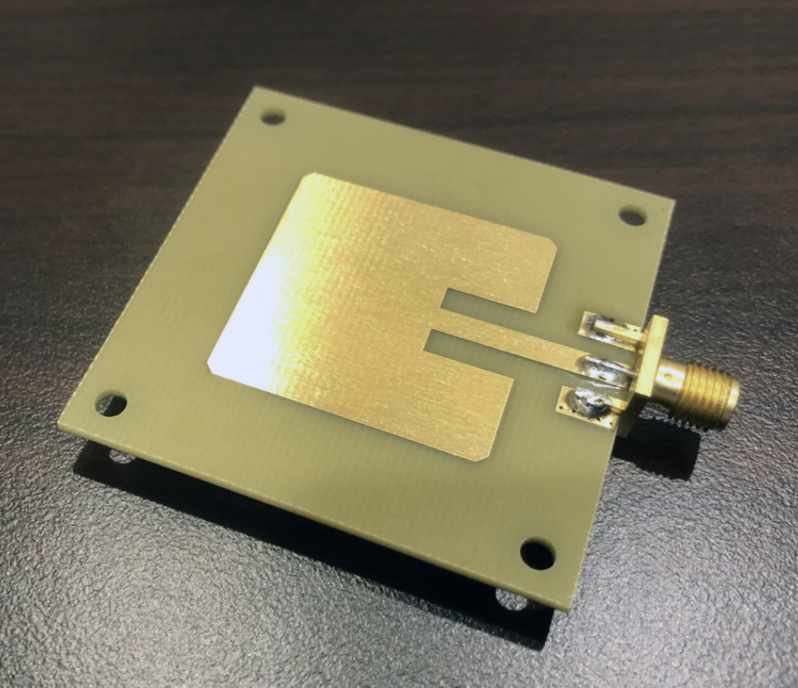
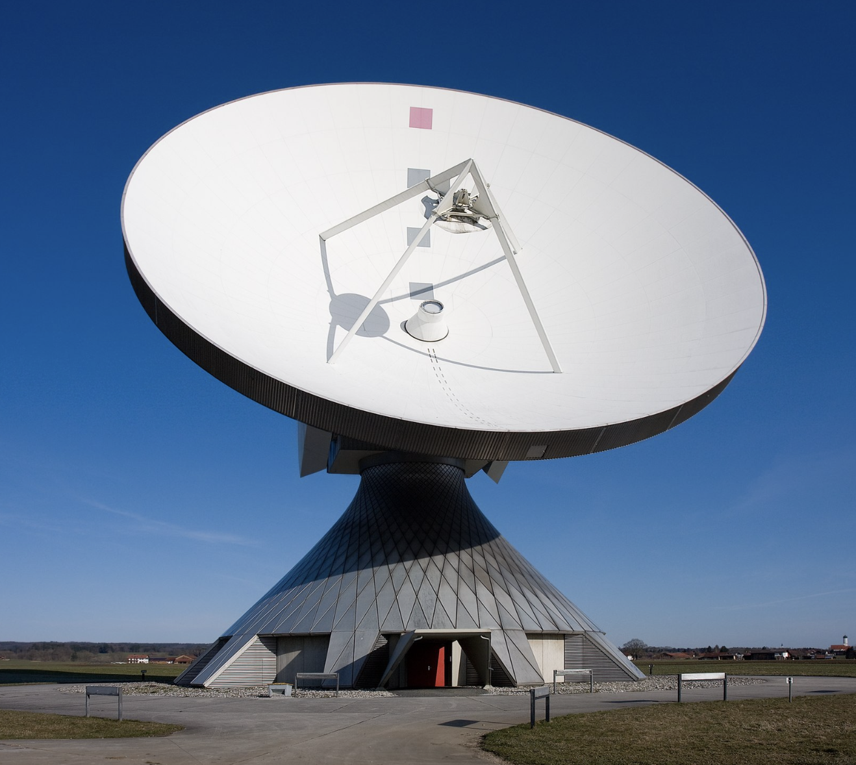
RF antennas in nature

Slide 4
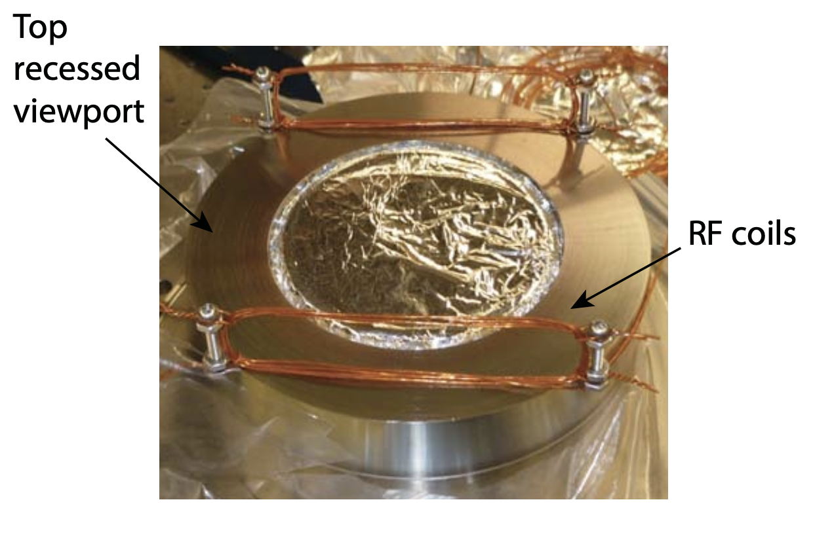
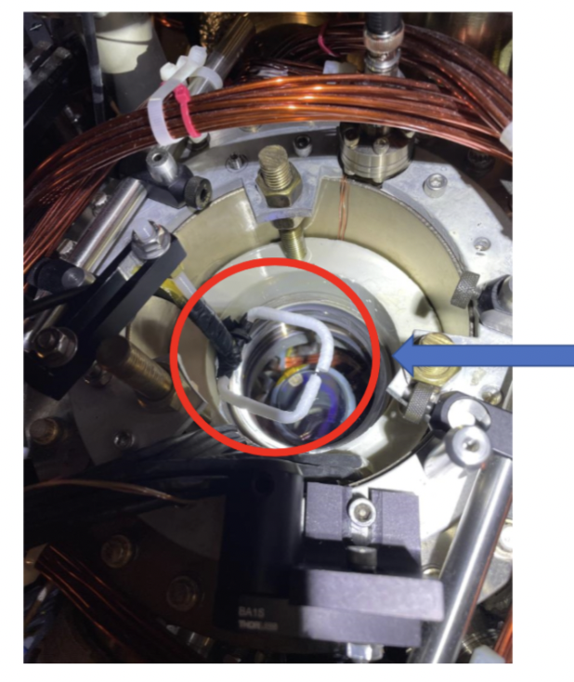
RF antennas in the lab (Fermi1)
for K spin
manipulation
F1 outer antenna
for Na RF Evap
CHW thesis
PC: Alex

Slide 5
Antenna design considerations
Type & material
Operating frequency range
Polarization of radiation
Antenna matching (“resonance”)
Tunability
Environmental effects
Cost (time and money)
Want:
Simulations before prototyping
Confidence in design
Understanding of antenna behavior
Reproducibility
Don’t want:
Design by trial and error (ineffective)
Not understanding antenna behavior
Voo-doo! Not reproducible

Slide 6
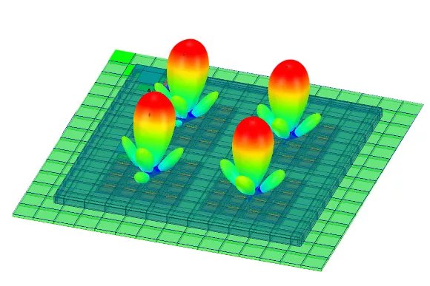
Ansys HFSS
Free*, powerful 3D EM solver
Relatively easy to learn and use:
Watch tutorials (YT/Ansys classes)
Build antenna
Set up solution and solve
Optimize
Alternatives:
COMSOL (very not free, IS&T has no license)
MATLAB (not enough features)

Slide 7
Modeling a waveguide antenna with Ansys HFSS in 10 steps

Slide 8
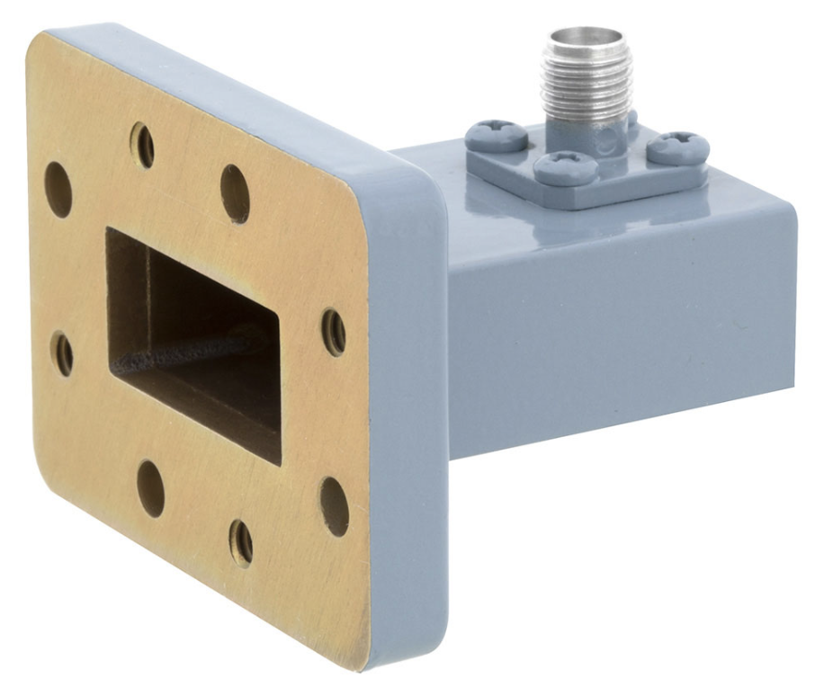
Step 1: Waveguide antenna requirements & dimensions
Operational frequency: 5.640 GHz
Tunable polarization
Direct radiation with high amplitude
Rectangular waveguide antenna
Width: needs lower frequency cutoff of TE01 < 5.64 GHz → a = 33 mm
Length: To be optimized
Feeds: Naively, 2 perpendicular feeds. 13 mm from backwall*, 10 mm tall
Hole in the backwall for the MOT beam
Inspired by Xing-Yan Chen et al, Nature, volume 614, pages 59–63 (2023)

Slide 9
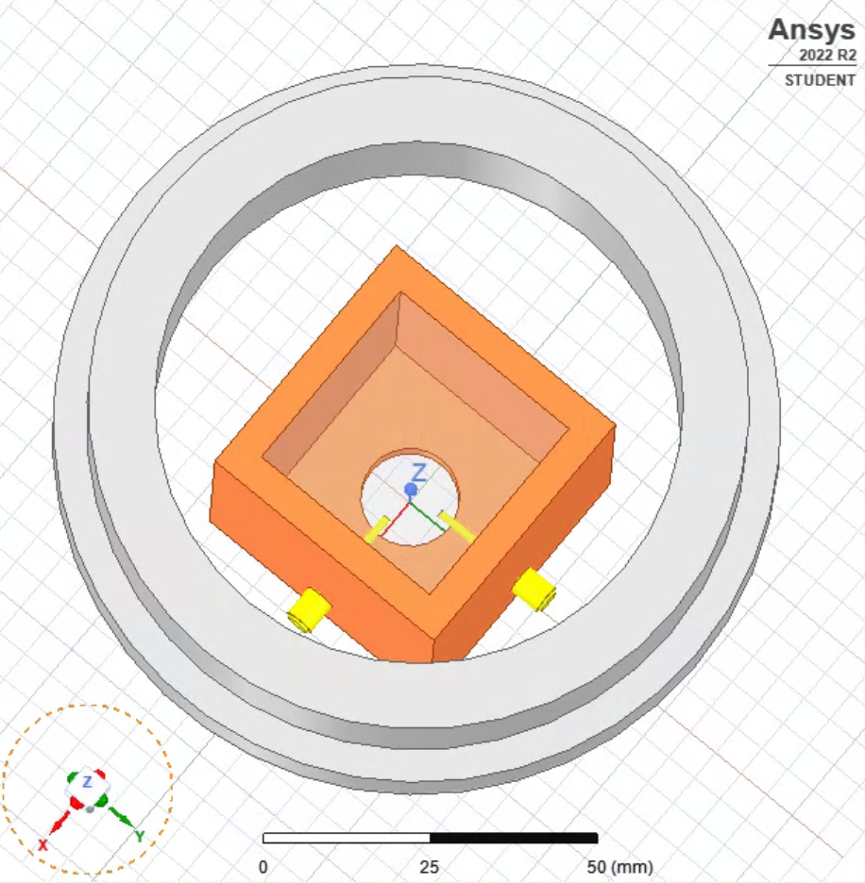
Step 2: Build the antenna in Ansys HFSS
<<< insert most current design, without the chamber! >>>
Remember to parametrize
Specify material
Feed dimensions: SMA stub connectors
Steel “ring” for the chamber window

Slide 10
Step 3: Define boundary conditions

Slide 11
Step 4: Define excitations

Slide 12
Step 5: Setup solution

Slide 13
Step 6: Validate and solve

Slide 14
Step 7: View results

Slide 15
Step 8: Study

Slide 16
Step 9: Optimize/Revise

Slide 17
Step 10: Finalize

Slide 18
Summary:

Slide 19
The end

